Slide 1
LSTM
Instructor: Dr. Yan Yan

Slide 2
Long Short-term Memory (LSTM)
Other part of the network
Special Neuron:
4 inputs,
1 output
Signal control the output gate
Output Gate
(Other part of the network)
Memory
Cell
Forget Gate
Signal control the forget gate
(Other part of the network)
Signal control the input gate
Input Gate
LSTM
(Other part of the network)
Other part of the network

Slide 3
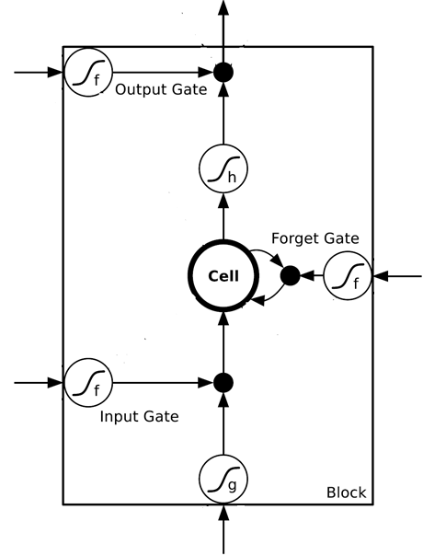



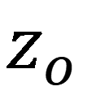






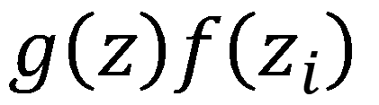
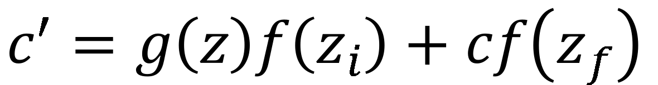
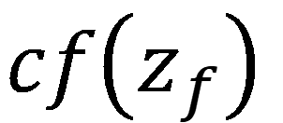


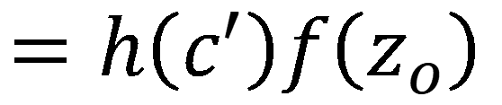
$$a$$
$$=h\left(c^{′}\right)f\left(z_{o}\right)$$
$$z_{o}$$
multiply
Activation function f is usually a sigmoid function
$$f\left(z_{o}\right)$$
$$h\left(c^{′}\right)$$
Between 0 and 1
Mimic open and close gate
$$c$$
$$f\left(z_{f}\right)$$
c
$$c^{′}$$
$$z_{f}$$
$$cf\left(z_{f}\right)$$
$$c^{′}=g\left(z\right)f\left(z_{i}\right)+cf\left(z_{f}\right)$$
$$f\left(z_{i}\right)$$
$$g\left(z\right)f\left(z_{i}\right)$$
$$z_{i}$$
multiply
$$g\left(z\right)$$
$$z$$

Slide 4
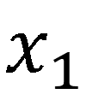

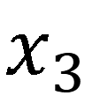
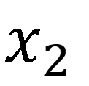
LSTM - Example
0
0
3
3
7
7
7
0
6
$$x_{1}$$
1
0
0
3
1
0
2
0
0
4
1
0
2
0
0
1
0
1
3
-1
0
6
1
0
1
0
1
$$x_{2}$$
$$x_{3}$$
$$y$$
0
0
0
0
0
7
0
0
6
When x₂ = 1, add the numbers of x₁ into the memory
When x₂ = -1, reset the memory
When x₃ = 1, output the number in the memory.

Slide 5
0
x₁
y
$$y$$
0
0
0
7
0
0
x₂
+
100
x₃
0
x₁
1
-10
100
0
0
+
x₂
x₁
0
x₃
100
x₂
+
10
1
0
x₃
1
-10
+
$$x_{1}$$
3
1
0
4
1
0
2
0
0
1
0
1
3
-1
0
1
0
0
0
$$x_{2}$$
x₁
x₂
x₃
1
$$x_{3}$$

Slide 6
0
≈0
3
y
$$y$$
0
0
0
7
0
0
1
+
≈0
3
100
0
0
3
1
-10
3
100
0
+
1
0
+
3
≈1
0
0
100
≈1
3
1
+
10
1
0
3
0
1
-10
+
$$x_{1}$$
3
1
0
4
1
0
2
0
0
1
0
1
3
-1
0
1
0
0
0
$$x_{2}$$
3
1
0
1
$$x_{3}$$

Slide 7
0
≈0
4
y
$$y$$
0
0
0
7
0
0
1
+
≈0
7
100
0
0
4
1
-10
3
100
7
+
1
0
+
4
≈1
0
0
100
≈1
4
1
+
10
1
0
4
0
1
-10
+
$$x_{1}$$
3
1
0
4
1
0
2
0
0
1
0
1
3
-1
0
1
0
0
0
$$x_{2}$$
3
1
0
1
$$x_{3}$$

Slide 8
0
≈0
2
y
$$y$$
0
0
0
7
0
0
0
+
≈0
7
100
0
0
2
1
-10
100
+
0
0
7
+
2
≈1
0
0
100
≈0
0
0
+
10
1
0
2
0
1
-10
+
$$x_{1}$$
3
1
0
4
1
0
2
0
0
1
0
1
3
-1
0
1
0
0
0
$$x_{2}$$
2
0
0
1
$$x_{3}$$

Slide 9
0
≈7
1
y
$$y$$
0
0
0
7
0
0
0
+
≈1
7
100
1
0
1
1
-10
100
+
0
0
7
+
1
≈1
0
1
100
≈0
0
0
+
10
1
0
1
1
1
-10
+
$$x_{1}$$
3
1
0
4
1
0
2
0
0
1
0
1
3
-1
0
1
0
0
0
$$x_{2}$$
1
0
1
1
$$x_{3}$$

Slide 10
0
≈0
3
y
$$y$$
0
0
0
7
0
0
-1
+
≈0
0
100
0
0
3
1
-10
100
7
-1
0
+
0
+
3
≈0
0
0
100
≈0
0
-1
+
10
1
0
3
0
1
-10
+
$$x_{1}$$
3
1
0
4
1
0
2
0
0
1
0
1
3
-1
0
1
0
0
0
$$x_{2}$$
3
-1
0
1
$$x_{3}$$

